Slide 1

The Machine Learning Process
Python 101
Sathish Ravichandran

Slide 2
Outline
What is Python?
Advantages of Python
How to Run Python
Text Editors
IDEs
Notebook Environments
How to Install Python….
Running our first code
Appendix: Installation Process

Slide 3

What is Python?
Python is an interpreted, high-level, general-purpose programming language. It was created by Guido van Rossum and released in 1991.

Slide 4
Advantages of Python
Easy to pick up
Readable code
Huge amount of open source libraries
Used by many major tech companies

Slide 5
How to Run Python
There are 3 Main types of development environments
Text Editors
IDEs
Notebook Environments

Slide 6
Text Editors
Works with variety of different file types
Needs to be customized with plugins and add-ons
Most popular
Atom
Sublime text

Slide 7
IDEs
Development Environment designed specifically for Python
Lots of extra functionality
Most popular
PyCharm
Spyder

Slide 8
Notebook Environments
Seeing input and output next to each other
Excels at demonstration, research, and teaching objectives especially for science
Great for Learning
Most popular
Jupyter Notebook

Slide 9
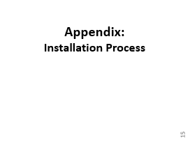
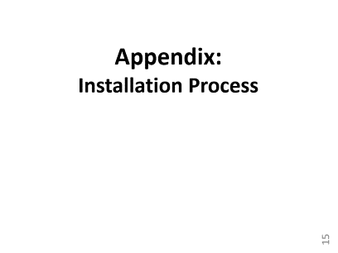
How to Install Python….
One of the best way to begin → Anaconda Distribution
Why?
It brings a good number of tools which are used in data science and machine learning with just one installation process.
https://www.anaconda.com/distribution/
You can follow the steps in the

Slide 10
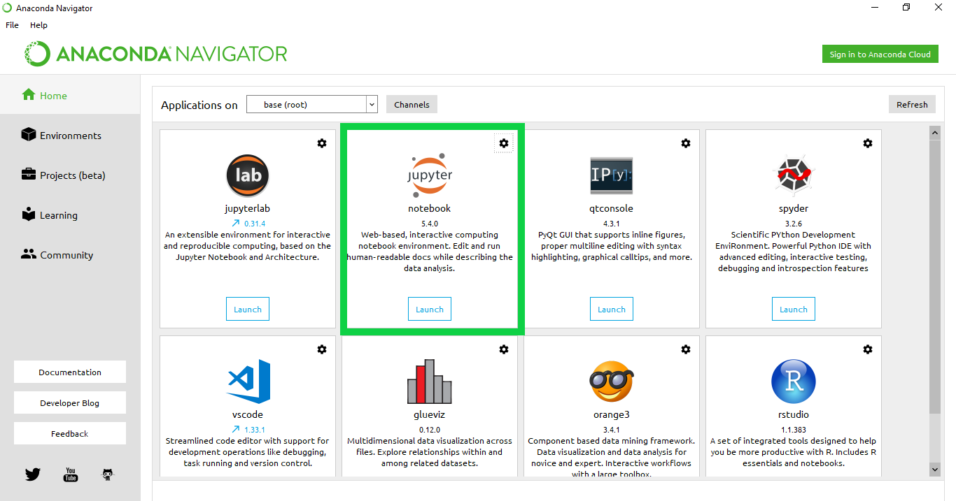
Anaconda Navigator → Jupyter

Slide 11
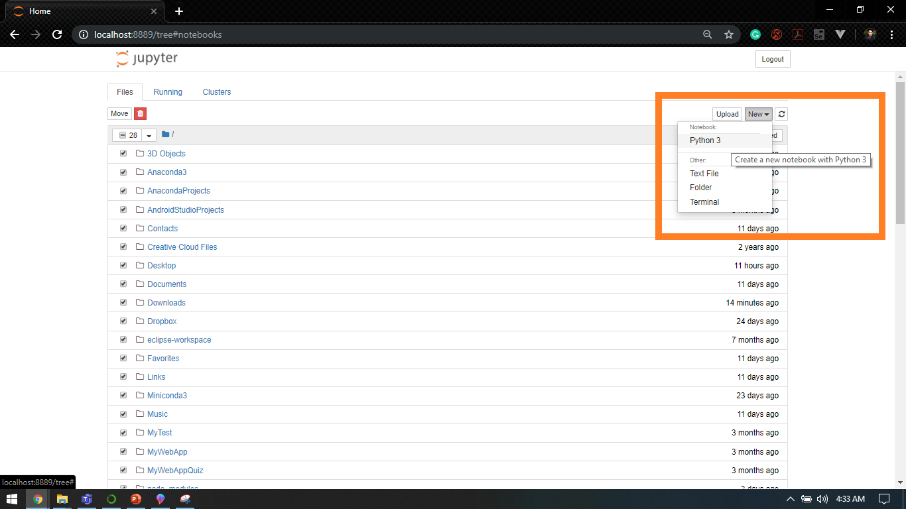
New Jupyter Notebook
Let’s create our first “Hello World” program…

Slide 12
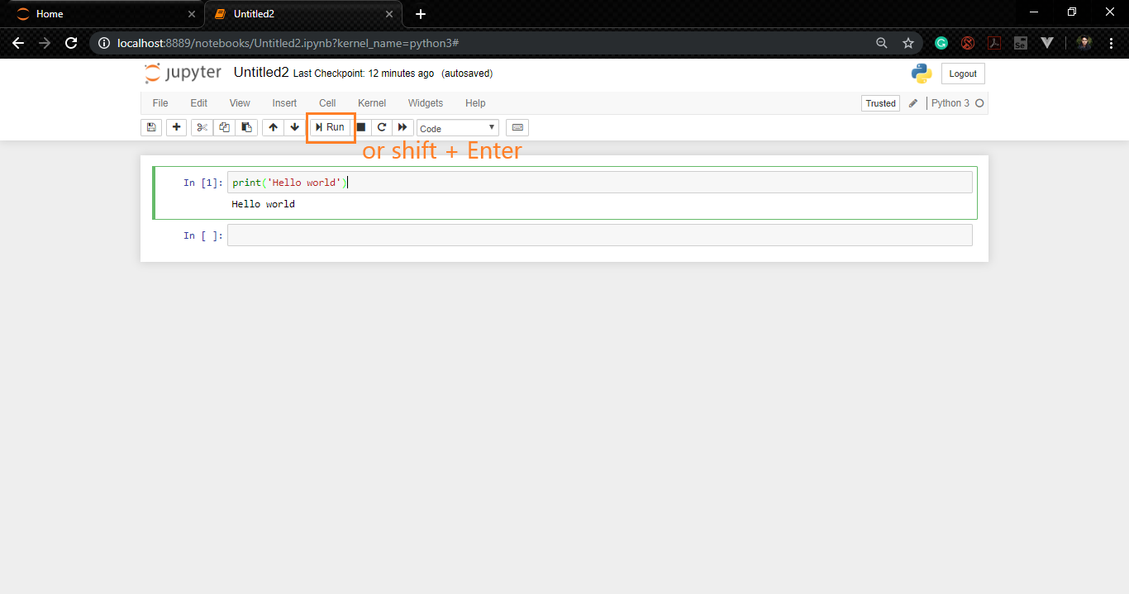
Running our first code
As simple as this… :)

Slide 13

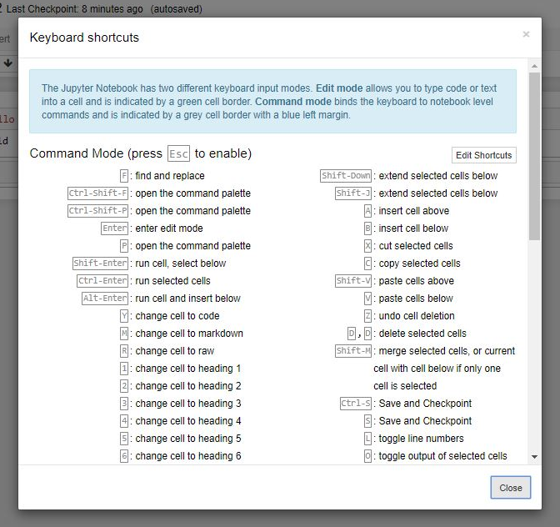
Help → Keyboard shortcuts
There are tons of nice shortcut keys and here is the list….

Slide 14

Thank you
Question?
To be
Not to be

Slide 15
Appendix:
Installation Process

Slide 16
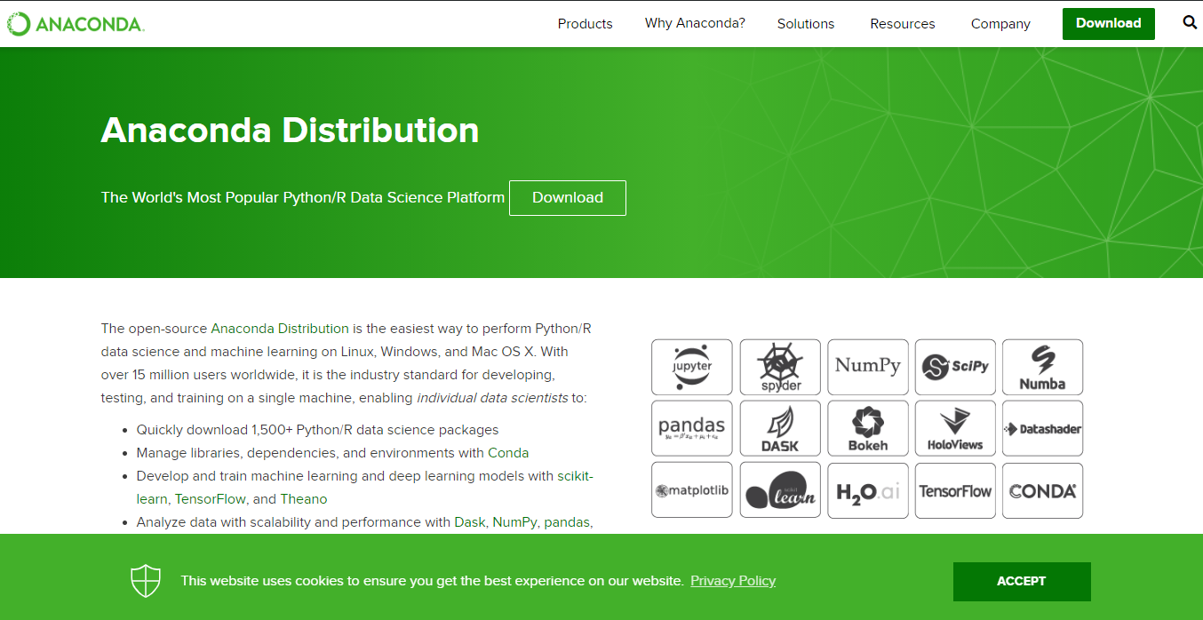
Anaconda Distribution of Python
Notes:
https://www.anaconda.com/distribution/

Slide 17
Anaconda Distribution of Python
2
1

Slide 18
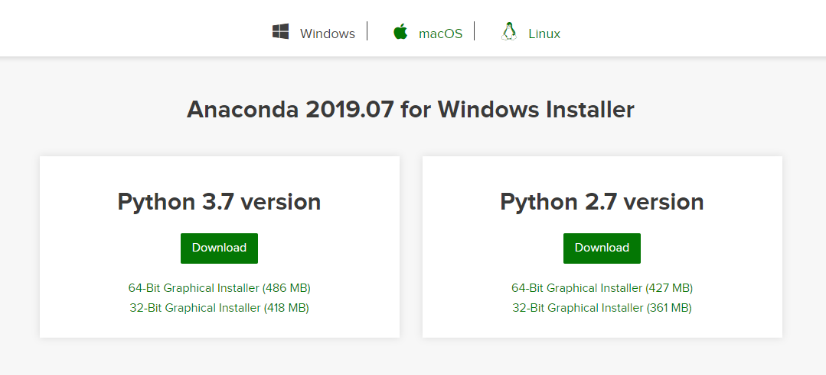
Anaconda Distribution of Python
1
2

Slide 19
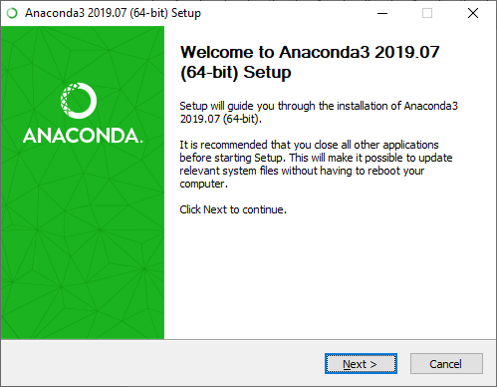
Installation Process
1
2

Slide 20
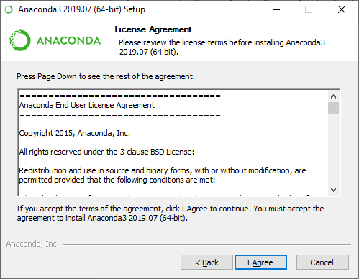
Installation Process

Slide 21
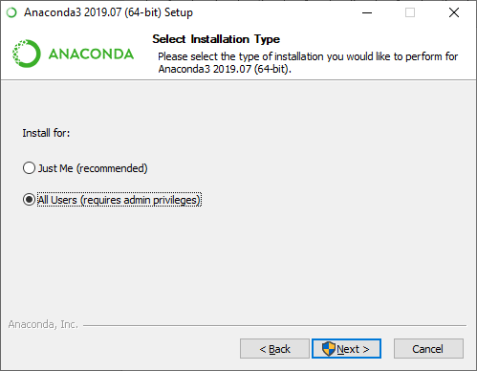
Installation Process
1
2

Slide 22
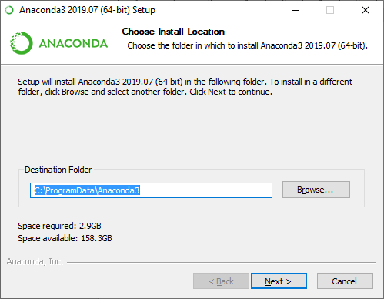
Installation Process
You can change the installation path or leave it as it is.
1
2

Slide 23
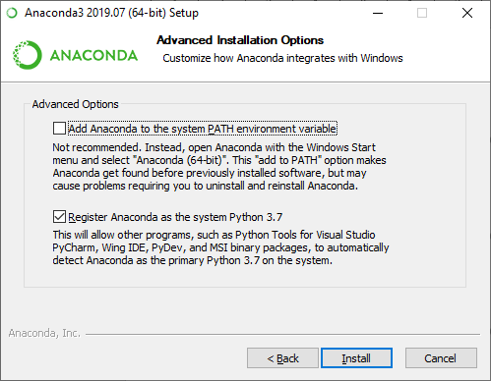

Installation Process

Slide 24
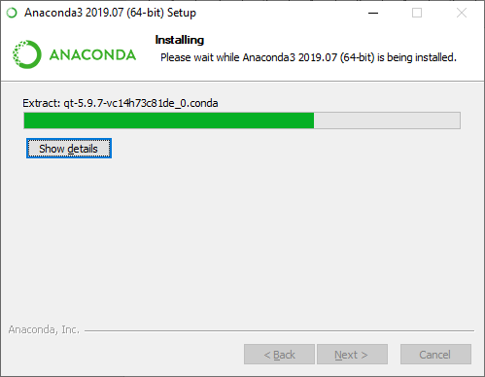
Installation Process

Slide 25
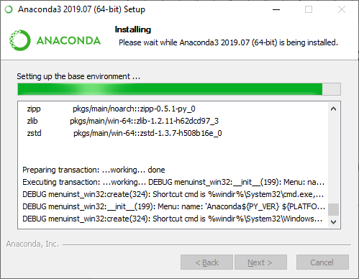
Installation Process

Slide 26
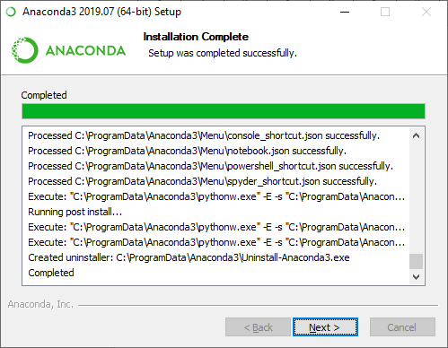
Installation Process

Slide 27
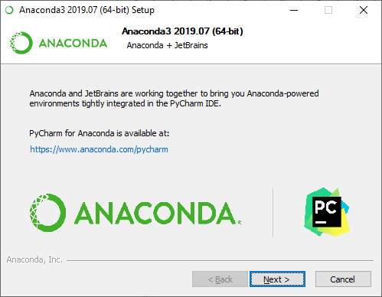
Installation Process

Slide 28
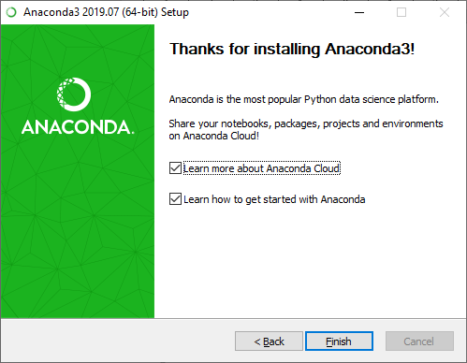
Installation Process

Slide 29
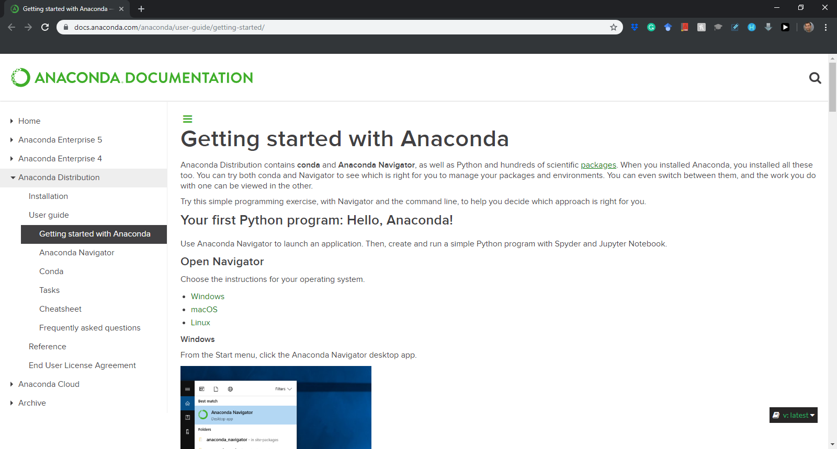
Installation Process
Notes:
https://docs.anaconda.com/anaconda/user-guide/getting-started/

Slide 30
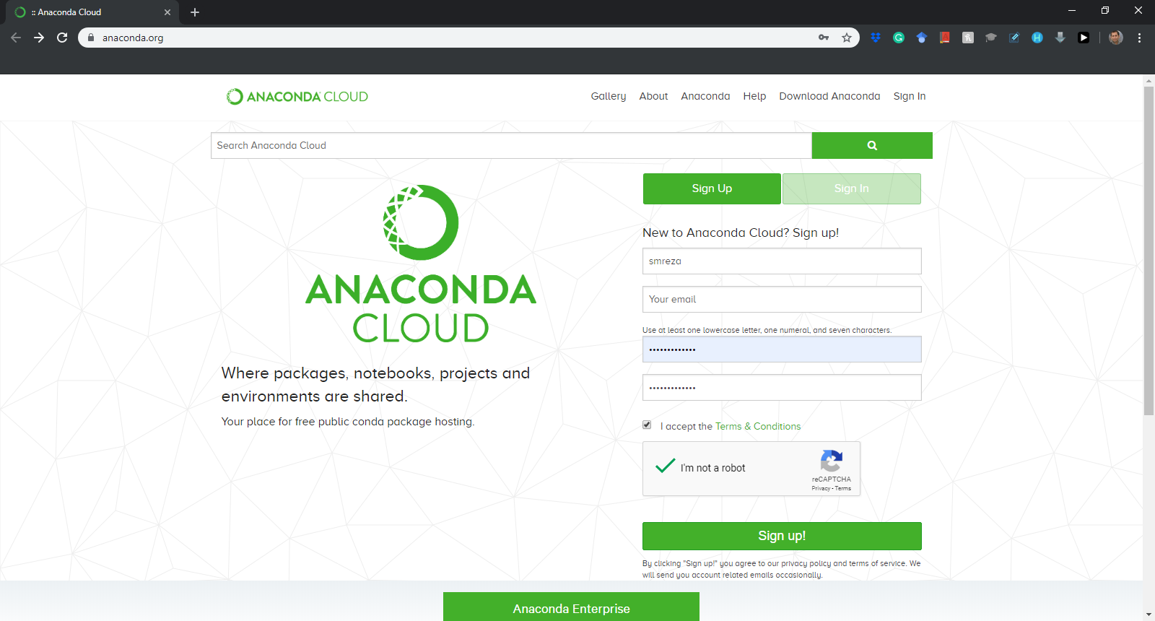
Installation Process
Sign up for the first time….
Notes:
https://anaconda.org/

Slide 31
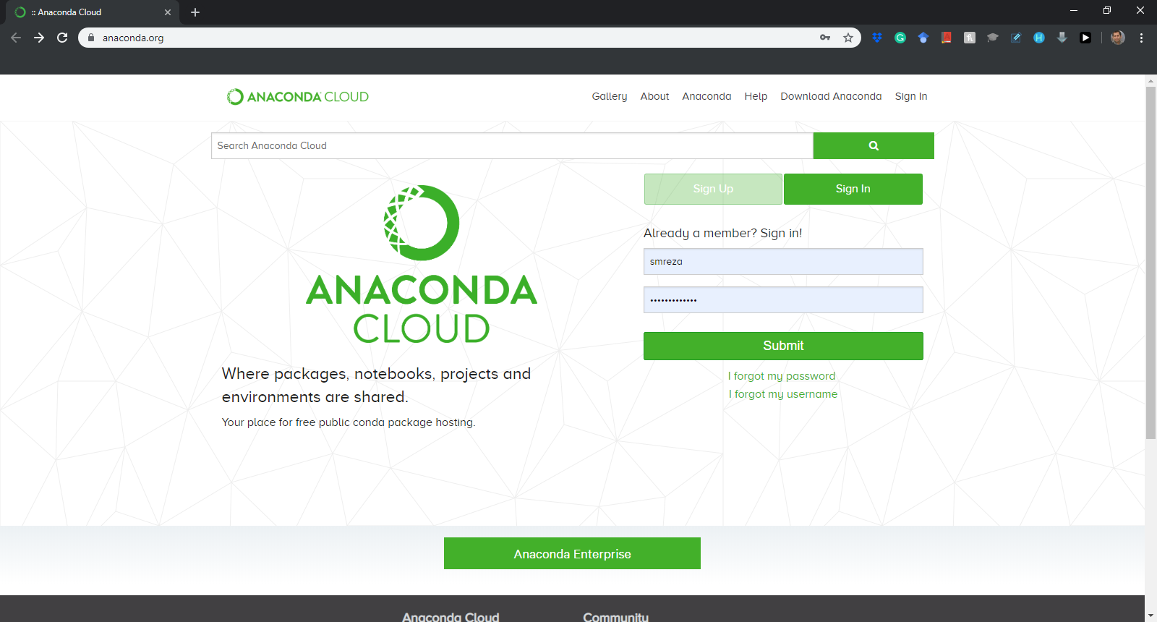
Installation Process
Sign in after the first time….
Notes:
https://anaconda.org/

Slide 32
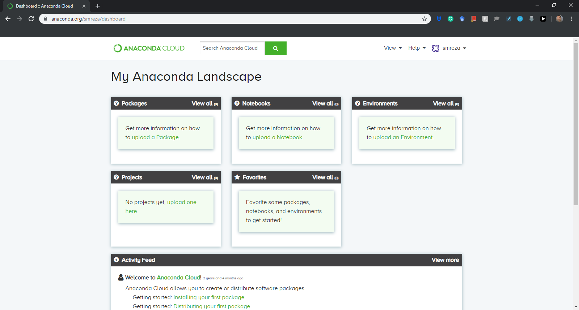
Installation Process

Slide 33
Installation Process

